Slide 1
Topic 5 - For Loops lesson 1

Slide 2

Learning objectives
In this lesson students will learn to:
  Define the terms ‘data structure’, 'array’ and 'list’
  Access each item in a list using indexing
  Create, append, and delete items from a list.
For more information on this topic, and additional student activities, see Topic 1.6 of the student book. – page 64 – 69
© Pearson Education Ltd 2020. Copying permitted for purchasing institution only.
Notes:
Spec content: 1.2.1 1.2.2 6.2.2 6.3.1 6.6.1

Slide 3
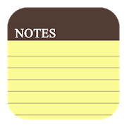
Storing data
Up to this point, you have been using variables to store data.
What is a variable?
A variable is a container for storing information. The container resides in memory and has a label to identify it.
It’s often necessary to store multiple pieces of information together in the same container.
A single variable on its own is usually not enough to do this.
© Pearson Education Ltd 2020. Copying permitted for purchasing institution only.

Slide 4
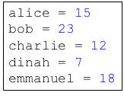
Storing more data
Imagine you wanted to store the amount of time, in minutes, each person in your class took to get to school.
You could do it like this:
But would this work for 25-30 people? It would take a long time and many lines of code.
There must be a better way!
© Pearson Education Ltd 2020. Copying permitted for purchasing institution only.

Slide 5
Arrays
A data structure is a container that can hold several items at the same time.
An array is one kind of data structure.
It contains a number of items grouped together. Named using a single identifier.
All the elements must be the same data type.
Each item is separated by a comma. (However, the comma is not actually stored in the array itself.)
minutes = [15,23,12,7,18]
Notice the square brackets
© Pearson Education Ltd 2020. Copying permitted for purchasing institution only.

Slide 6
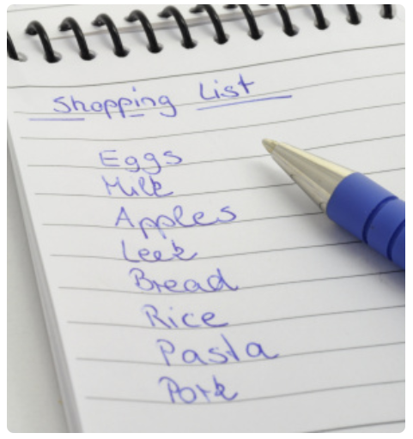
Lists
A list is another type of data structure.
Lists - can be used to manipulate the elements they contain.
Consider a shopping list. What should you be able to do to a shopping list?
  add an item
  delete/remove an item
  sort/order the items
  copy the list
  delete the whole list.
© Pearson Education Ltd 2020. Copying permitted for purchasing institution only.

Slide 7
In Python
Each programming language uses its basic data structures to implement other data structures.
In Python, the ‘list’ is the most basic data structure. It is used to implement arrays.
Here is an example of a Python list used to implement arrays.
What data types do the arrays hold?
What do you think the last line does?
numStudents = [32, 30, 30, 28, 29]
temperatures = [35.7, 36.2, 37.1, 36.0]
girlNames = ["Fryia", "Meenal", "Chanda"]
paidFee = [True, False, False, True]
myList = []
© Pearson Education Ltd 2020. Copying permitted for purchasing institution only.
Notes:
Student Activity 1

Slide 8
Indexes (Indices)
An individual element of an array can be accessed using an index to its location.
As with strings, indexes start at 0.
For example:
Would output?
minutes = [15,23,12,7,18]
print(minutes[2])
12
© Pearson Education Ltd 2020. Copying permitted for purchasing institution only.
Notes:
Student Activity 2

Slide 9
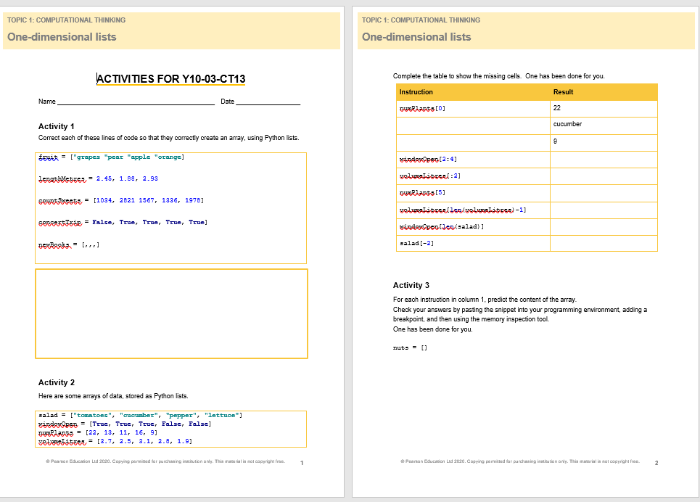

Activity Sheet – Do Task 1 & 2
© Pearson Education Ltd 2020. Copying permitted for purchasing institution only.

Slide 10
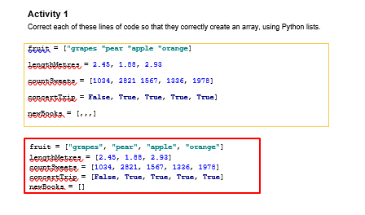
Activity 1 Solution
© Pearson Education Ltd 2020. Copying permitted for purchasing institution only.

Slide 11

Activity 2 Solution
© Pearson Education Ltd 2020. Copying permitted for purchasing institution only.

Slide 12

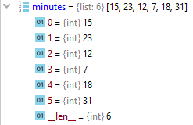
Adding new items
You can add new items to the end of an existing list using append.
Set a breakpoint here so you can examine memory.
New value is added on here.
Index value.
Notice it starts from 0.
Note about PyCharm:
The debugger is showing the length of the array and its type here.
This is metadata.
© Pearson Education Ltd 2020. Copying permitted for purchasing institution only.

Slide 13

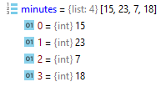
Removing elements
You can remove values from a list (array) using remove.
remove(item)works by searching for the first element in a list that has the value of item and then removing it.
For example:
What will be printed out when this program is run?
© Pearson Education Ltd 2020. Copying permitted for purchasing institution only.

Slide 14
Deleting elements
However, using remove can cause some issues.
What if the value doesn’t exist?
What if there’s more than one of the same value and you want to remove the second and not the first?
This is where delete comes in.
© Pearson Education Ltd 2020. Copying permitted for purchasing institution only.

Slide 15

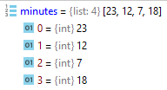
Deleting items
Notice that the syntax for delete is slightly different.
The result of delete is much more predictable, so it is best practice to use delete rather than remove.
This is the index of the item to delete.
© Pearson Education Ltd 2020. Copying permitted for purchasing institution only.
Notes:
Student Activities 3 and 4

Slide 16
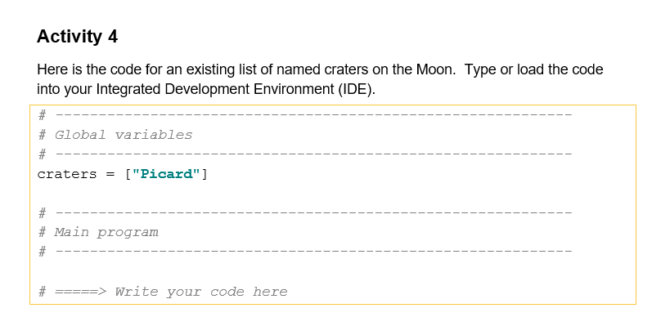
Have a go at this task.
© Pearson Education Ltd 2020. Copying permitted for purchasing institution only.

Slide 17
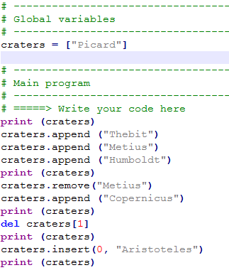
Print out the list
Adds “Thebit” to the list
Print out the list
Removes “Metius” from the list
Adds “Copernicus” to the list
Deletes the second item in the list
Adds “Aristotles” to the first position in the list – first position is 0.
© Pearson Education Ltd 2020. Copying permitted for purchasing institution only.

Slide 18
Wrap up: you have learned how to…
Define the term ‘data structure’.
  A collection of data stored under one identifier.
Define the terms 'array’ and 'list’.
  An array is a data structure where all the elements are homogenous (i.e. have the same data type).
  In Python, a list is used to implement the ‘array’ concept.
Access each item in a list using indexing (in a similar way to strings).
  Use [ ] with index values starting from 0.
Add, append, and delete items from a list.
  list.append(x) adds element x to the end of the list.
  list.remove(x) removes the first instance of element x from the list.
  del list[x] deletes the item at index x.
  Pages 64 – 69 in the text book.
© Pearson Education Ltd 2020. Copying permitted for purchasing institution only.

